Slide 1
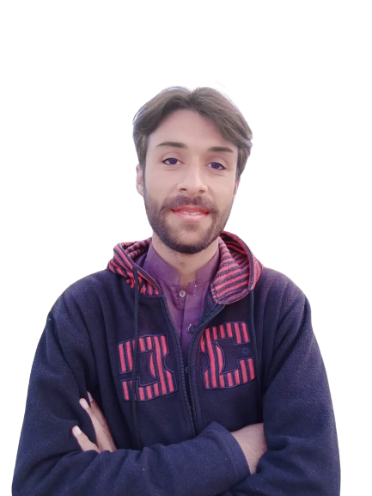
Intermediate Task Series
Problem Number 77

Slide 2
Problem Statement
Create a Desktop Python program to create a window and set its title

Slide 3
Algorithm
Step1: Import tkinter package
Step2: Create a basic window
Step3: Provide a title to window
Step4: Display result to user
END

Slide 4
Assignment
Create a Desktop Python program to provide width and height to window.

